Slide 1
SCS 2102 GROUP PROJECT -01 CS GROUP- 29

Slide 2

Our..
Supervisor
Mr. Rangana Jayashanka
Co-supervisor
Ms. Kamsa Sharma

Slide 3

Team Members
R.P.Ranaweera | 18001327
W.T.Gihan | 18000576
G.G.N.N.Wanigasekara | 18001823
H.M.D.Thathsara | 18001696

Slide 4

Our Client…
Mr. Indigahawalage Sudeera
No:502,Bypass Rd,Weligama.
+94-76 729 3945
bayfrontwell45@gmail.com
Bay Front

Slide 5
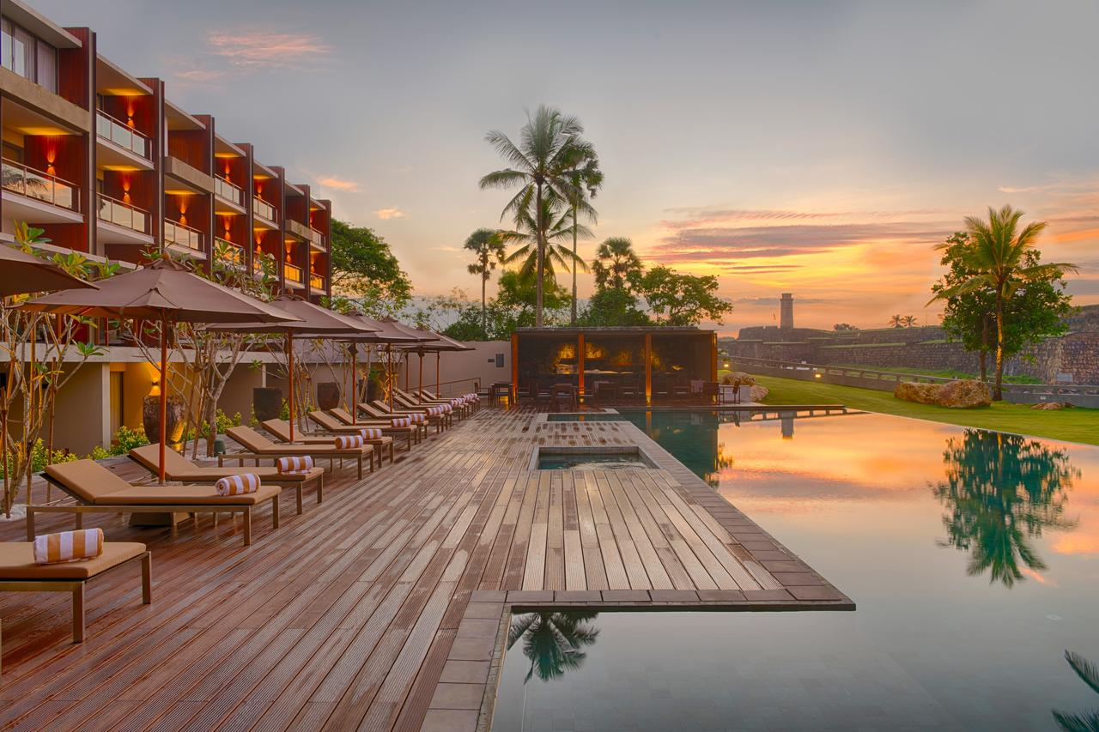
Introduction
‘Hotel Bayfront’ is one of famous hotel in southern coast-line. But this hotel currently using manual system.
We are trying our best to develop their Reservation system as web based Hotel Management System including all the functionalities required by the client.
5

Slide 6

PROBLEM IDENTIFICATION

Slide 7

Problems
Making reservation process manually.
All activities are stored under file-based system.
Problems with money transaction
Inability to manage customer information properly
Poor communication with customer

Slide 8

Our Solutions
Online reservation System.
Online payment system.
Establish a systematic database of all customer details
Notification System
Generate the Reports
Easy to access system

Slide 9

PROJECT SCOPE

Slide 10

Goal
Creating a web-based system for our client to maintain a good customer relationship and make a secure online environment for the hotel.

Slide 11

Our Objectives
To manage the hotel using a computerized system.
To make efficient and effective use of the hotel system.
Real information on availability of the booking component.
To Ensure customer satisfaction.
The system should support a multi-user environment.
To manage large volumes of data to acquire timely and accurate information

Slide 12

System Boundary
In Scope
Customer registration
Room reservation system
Notification system
Available content editing
Manage employee
Generate the Reports
Write feedback

Slide 13
System Boundary
Out Scope
System Advancement due to the addition of future branches
The system can be used only to add, delete, or modify employee details.

Slide 14
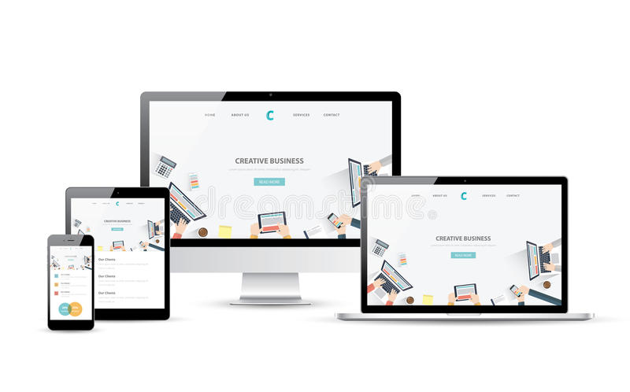
Deliverables
A Web Application with
Attractive and understandable user-friendly interface.
Responsive to Desktop, Tablet, and smartphones
User manual documentation

Slide 15

Stakeholders
Customer
Unregistered Customer
Registered Customer
Receptionist
Owner

Slide 16
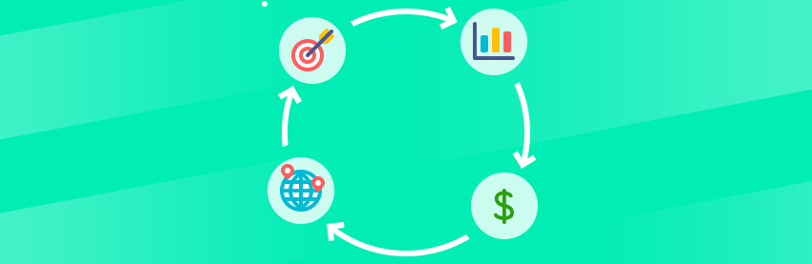
Project Feasibility

Slide 17

Technical Feasibility
The project can be done by using existing technologies.
Current technical resources can be upgraded to provide the level of technology necessary for the system.
The team is equipped with the knowledge and expertise needed to develop the system using current technologies.

Slide 18

Operational Feasibility
The system is to provide adequate throughput and response time.
The system allows the receptionist/owner to adapt without any specialized training with no time. This is a user-friendly system that makes it easy for the Customer.
The report generating feature provides a report accurate and useful formatted information from the system.

Slide 19
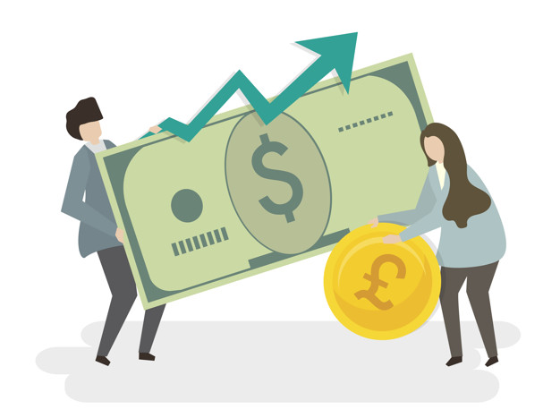
Economical Feasibility
Free and open source technologies are used in developing this system.
Even though at the beginning domain, hosting and maintenance will need some expense, the benefits from the system outweigh the cost.
The system is very much affordable.

Slide 20

Legal Feasibility
Free and open source technologies are used mostly. If not proper copyrights are used.
Information security is assured. They will not be used without the expressed permission of the Customer.
Proper user privileges will be set for the groups or individual.
The execution of the system does not breach any laws of the country.

Slide 21

Schedule Feasibility
We have planned and scheduled how and when we are going to implement each part of the system.
We will most certainly be able to implement the system within the estimated period, and it is shown in the Gantt chart shown below.

Slide 22
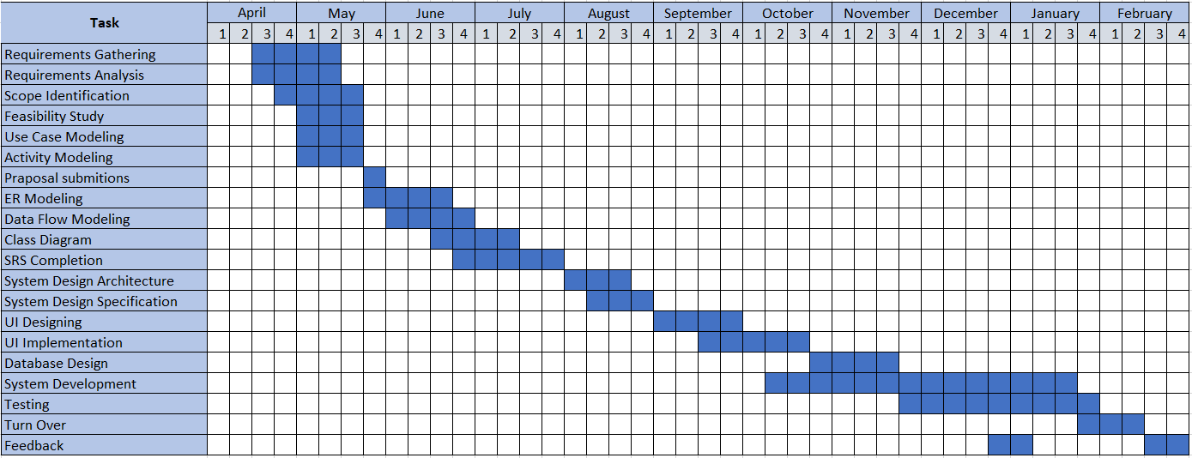
Grant Chart

Slide 23
Workload Distribution
Name | Component
R.P.Ranaweera | Requirement gathering Designing the ER diagrams, Class Diagram Preparing the SRS and interim documents. Reservation system, Available Content Editing with full stack development. Testing automation
W.T.Gihan | Requirement gathering Designing the ER diagrams, the Sequence Diagrams. Preparing the SRS and interim documents. Payment system, Employee management system with full stack development. Testing automation
G.G.N.N.Wanigasekara | Requirement gathering Designing the ER diagrams, Class Diagram Preparing the SRS and interim documents. Report generating system, Employee management system with full stack development. Testing automation
H.M.D.Thathsara | Requirement gathering Designing the ER diagrams, the State Transition Diagrams. Preparing the SRS and interim documents. Notification system, Available Content Editing with full stack development. Testing automation

Slide 24

Functional Requirements Identification

Slide 25

Unregistered Customer
Create customer account
It can only access the static web pages on the web application.
Home
Rooms & suites
Dining
Surf packages
Gallery
About us
Contact
Guest review

Slide 26

Registered Customer
Log in website
It can access the static web pages on the web application.
Reserving room
Ability to cancel the booking
Ability to change room
Ability to extend the reservation period
Reserving surfing package
Ability to change package
Online payment facilities
Give feedback

Slide 27

Owner/(Admin)
Log in website
It can access the static web pages on the web application.
Handle the walk-in guest
Monitor the cash payment
Handle the booking process
Edit the website
Manage employee details
Generate summary reports

Slide 28

Receptionist
Log in website
It can access the static web pages on the web application.
Handle the walk-in guest
Monitor the cash payment
Handle the booking process

Slide 29
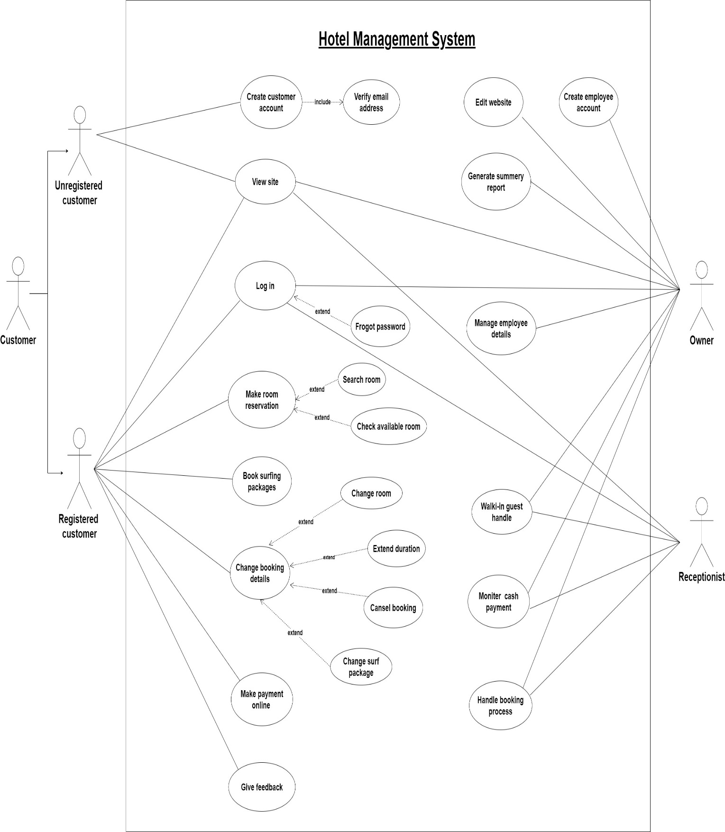
Use case Diagram

Slide 30
Unregistered Customer

Slide 31
Registered Coustomer

Slide 32
Owner/(Admin)

Slide 33
Receptionist

Slide 34

Non-Functional Requirements

Slide 35
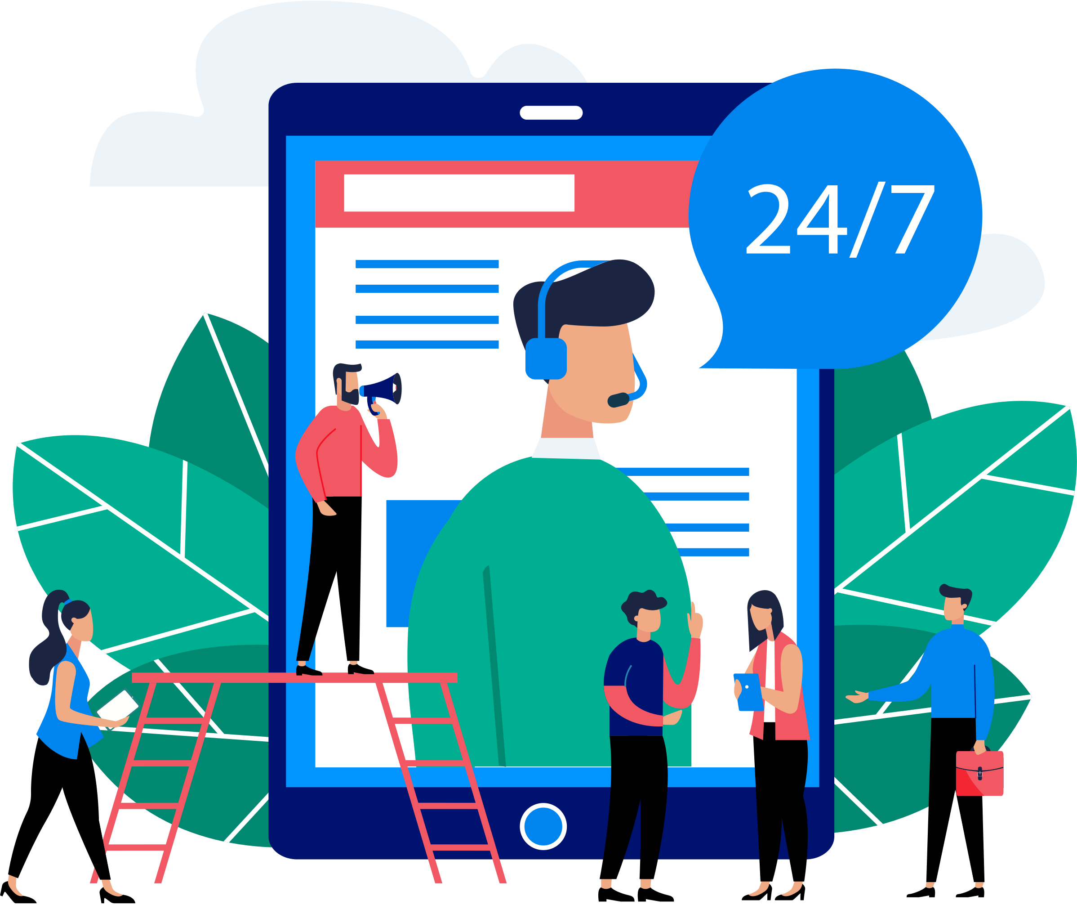
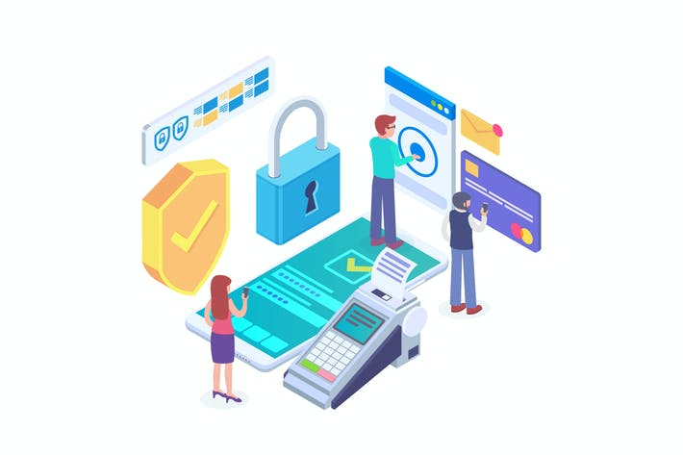
Non-Functional Requirements
Availability
Usability
Security& Privacy
Portability
Reliability

Slide 36

HIGH LEVEL SYSTEM ARCHITECTURE

Slide 37
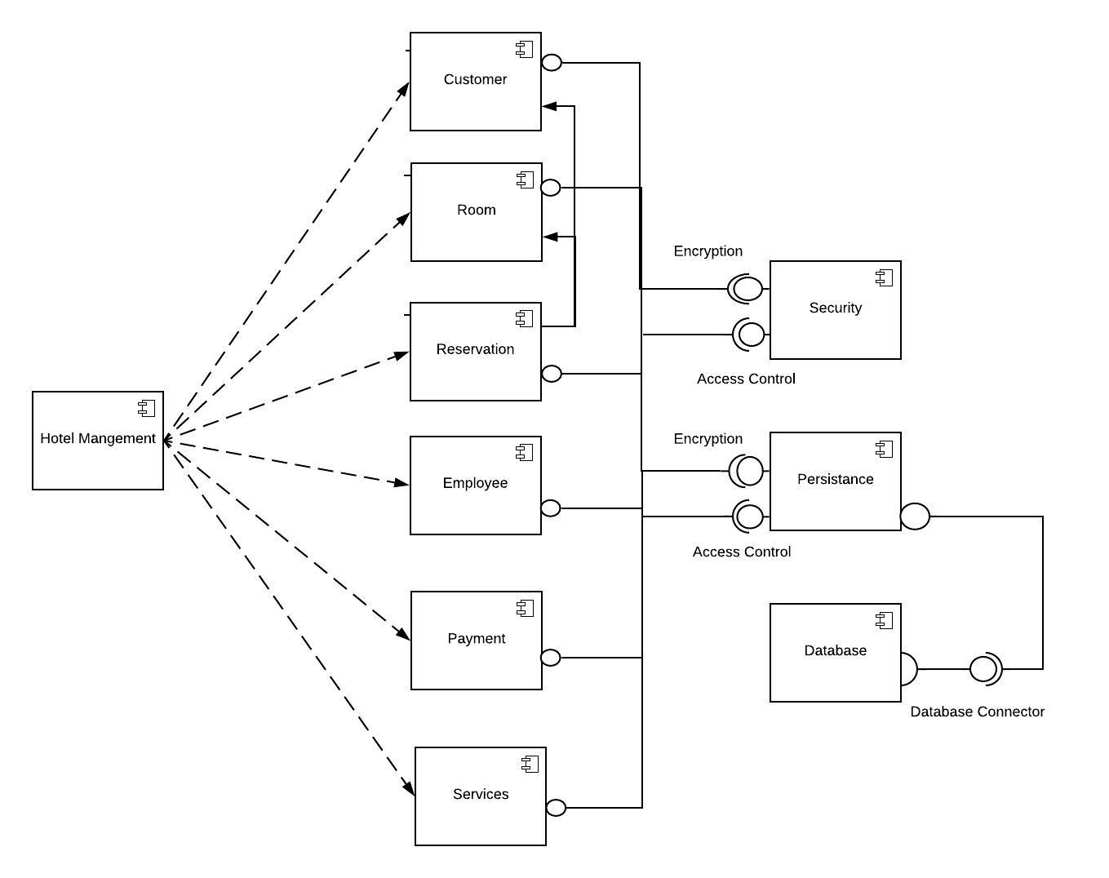
Component Diagram

Slide 38




Three-Tier Architecture
Receptionist
Admin/Owner
Customer
Presentation
Tier
Admin Panel
Front-end
Front-end
Payment system
Reservation system
Notification system
Application
Tier
Available Content Editing
Employee management system
Report generating system
Data Tier
Database

Slide 39





Front-end
Technology to be used
HTML 5
CSS 3
JAVASCRIPT
Back-end

Slide 40







Project Management
Prototype Designing

Slide 41

THANK YOU
Insert Image

Slide 42


